Slide 1



USMTF NIEM ICP
Initial Review & Thoughts
“POWER TO THE EDGE”

Slide 2
Outline
Objectives and Status
Testing and Lessons Learned
Program Managers and Adoption
Thoughts and Recommendations
Summary and Questions

Slide 3
Army Situation
Wanted to participate, but lost all contractor support and most funding for 2+ years
Contracts & funding just re-established in 2017
NIEM ICPs are one of the top priorities
Review and testing started immediately

Slide 4
Review Objectives and Approach
Objectives
Provide technical review and feedback
Ensure changes are adopted by programs
Avoid lengthy implementation delays
E.g., 2000/2004 ATO, ACO, etc.
Approach
Engage with programs and users to socialize
Collect feedback and foster ownership / buy-in
Begin testing to identify impacts on programs / users

Slide 5
Current Status
Completed initial ICP reviews
Completed initial impact testing
Started engaging with Army programs and users

Slide 6
ICP Review
An amazing amount or work completed
Over 3000 changes impacting most messages & sets
Field changes are even more significant
Addressing most NDR requirements
Garden of Eden schema design pattern
Replacing xs:choice with substitution groups
Acronym usage and documentation
NIEM representation terms (e.g., Code, Numeric, Text, Quantity, ID, etc.)

Slide 7
“Test everything; retain what is good.”
Early Developer Guidance
1 Thessalonians 5:21
Testing and Lessons Learned
“The intended consequences sometimes happen.
The unintended consequences always happen.”
Richard Rollman
VP Engineering, AgileDelta
(AKA Pessimist Prime)
“POWER TO THE EDGE”

Slide 8
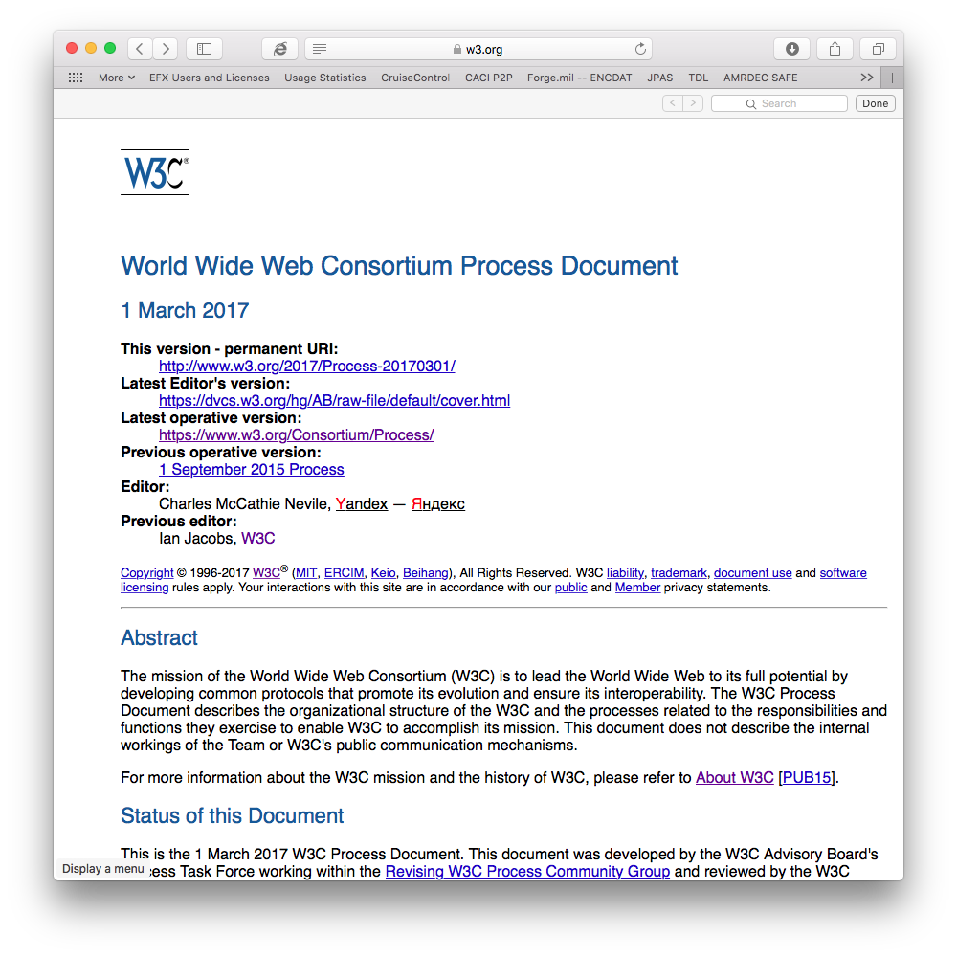
W3C Approach
“Implementation experience is required to show that a specification is sufficiently clear, complete, and relevant to market needs, to ensure that independent interoperable implementations of each feature of the specification will be realized.”
For EXI, 3000+ test cases covering every aspect of spec
3 independent implementations
Found several issues, even after review by world’s top experts
I.e., all standards should be thoroughly tested before they are final

Slide 9
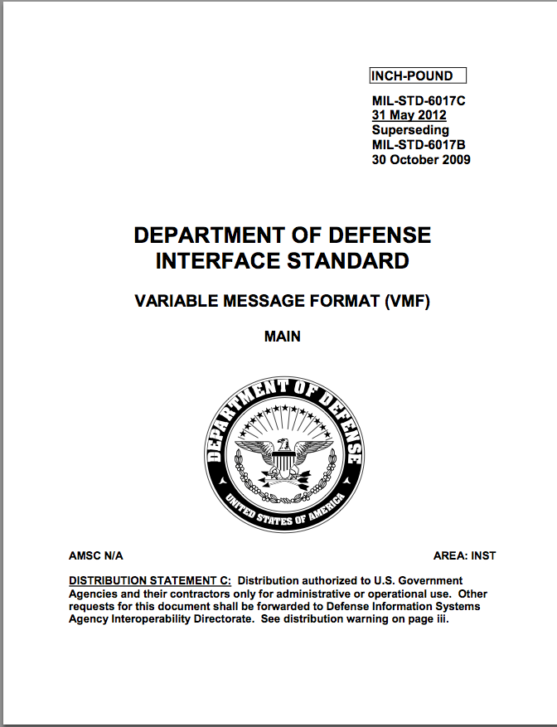
VML (XML-VMF) Approach
4
Compare
VMF
2
<xml>
3
VMF
VMF2XML
XML2VMF
VID
1
<xsd>
SchemaGen
<xsd>
<xsd>
Successful testing completed for over 1000 test messages
- Covered all VMF message types and cases
- Included 2045-47001 headers
- Included digitally signed and compressed messages
- Included JITC tests with good coverage of edge cases
MIL-STD 6017
Result: Found and fixed a dozen significant issues before finalizing

Slide 10
Initial USMTF NIEM Testing
Primary Objective
Assess impacts on implementers and users
Tests completed
Schema-driven binding models (i.e., JAXB)
Schema-driven editors and data mappers
Schema-driven validators

Slide 11
Schema-Driven Binding Models
Binding Models
The primary method web-service platforms provide for sending, receiving and processing XML
Used by most net-centric systems (e.g., DCGS, AOC-WS, DDS, CANES ACS, GCCS, etc.)
How they work
Developer provides schemas to a “binding compiler”
Binding compiler generates code for creating and processing all elements and types in the schema
Developer uses generated code to send / receive XML
E.g., JAXB (Java API for XML Binding)
The Java standard for XML binding used by all Java application servers and web-service clients.

Slide 12
Binding Model Test
Purpose: evaluate what a typical web-service developer must do to implement the NIEM ICPs
Process
Create a simple application that uses JAXB to read and display data from a 2016 COMSPOT message
Update the app to use the NIEM COMSPOT message
Characterize level-of-effort and any notable issues

Slide 13
Binding Model Test
Generate JAXB classes from 2016 COMSPOT schemas
Review Eclipse IDE developer assistance (from schemas)
Assess impact of typical change (i.e., add a field)
Assess impact of updating to NIEM COMSPOT schemas
> Demo

Slide 14
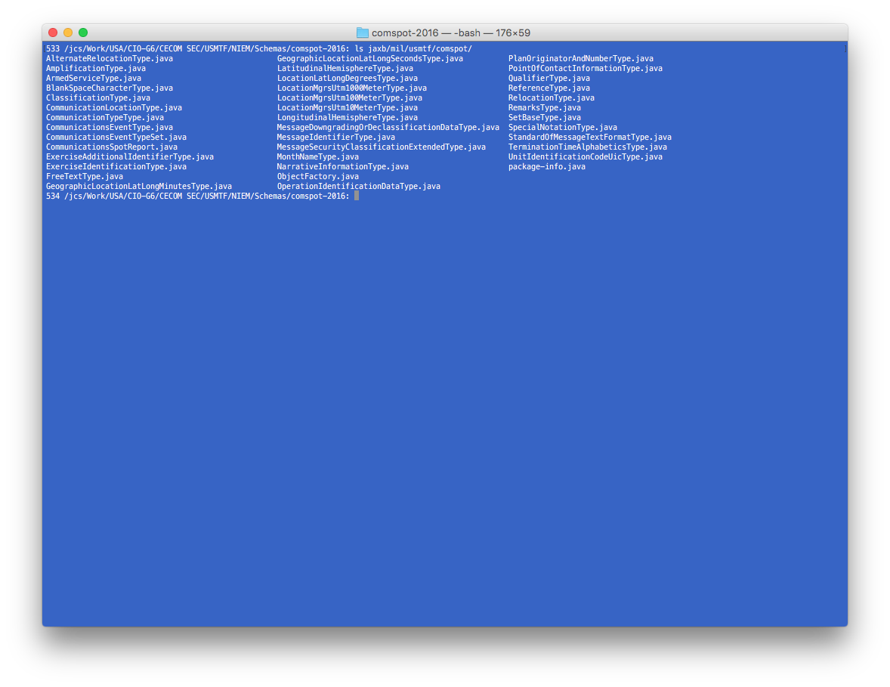
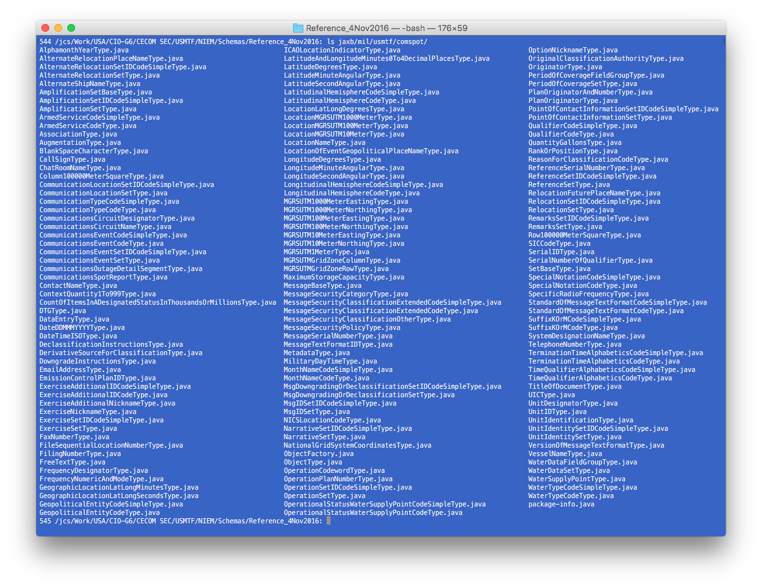
JAXB Class Generation
2016 schemas generated 40 Java classes
NIEM schemas generated 167 Java classes due to increased global elements, augmentation points, substitution groups, etc.

Slide 15
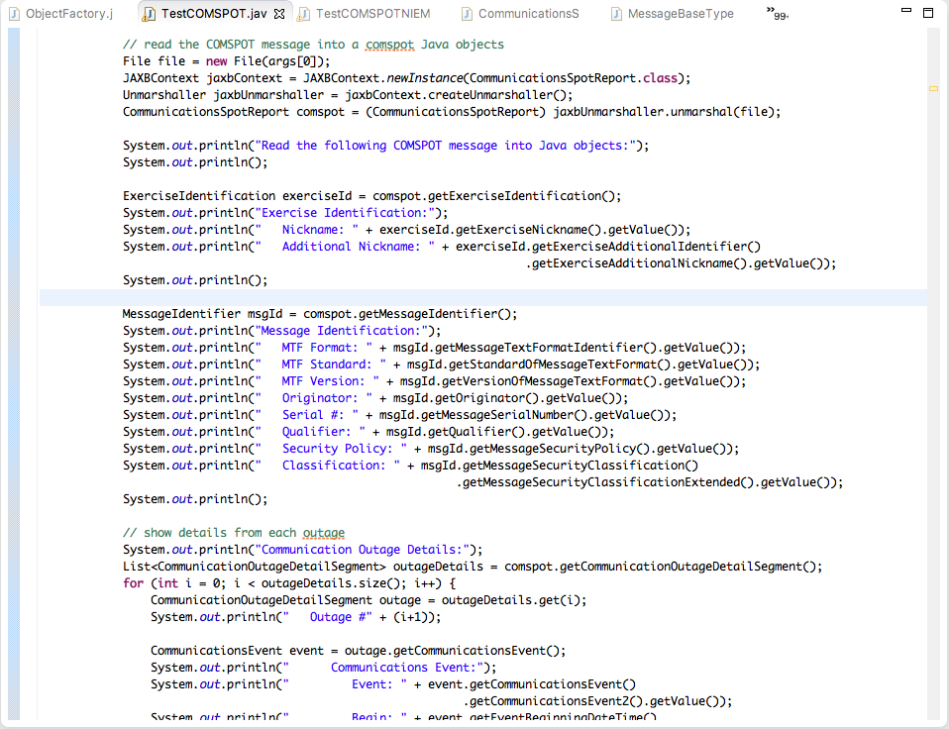
JAXB Code using 2016 Schemas
<ExerciseIdentification>
<MessageIdentifier>
Note: Venetian Blind schemas result in very simple code where all types and getter functions match XML element names

Slide 16
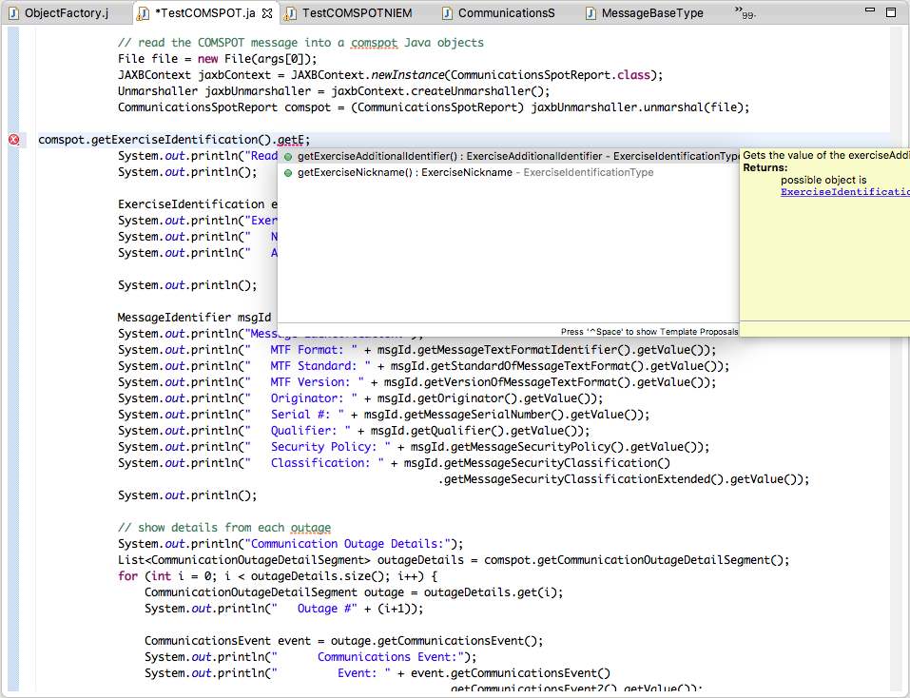
IDE Help with 2016 Schemas
Typing partial name shows available matches
IDE provides code completion and help finding all desired items in message. Makes it really easy to write code without combing through schemas for names.

Slide 17
Impact of Typical Schema Change
Adding elements to schema generates no errors and requires no changes to code. Developer can update code to use newly added elements when and if needed.

Slide 18
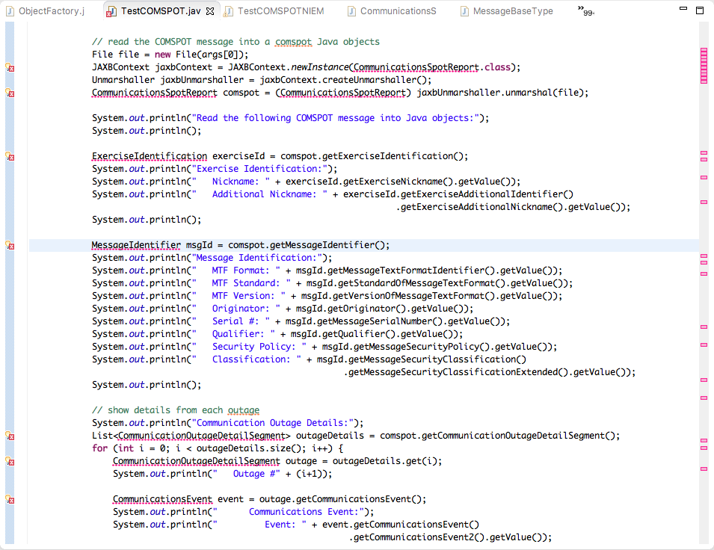
Impact of NIEM Schema Change
Updating to NIEM schemas results in many errors. All the existing types and getters for messages, segments and sets no longer work due to name changes.
Notes:
Introduces 24 error (msg, segs, sets and imports)
Fixing reveals 25 more (fields)
Fixing reveals 27 more (alternates and composites)
36 lines of code were not impacted. 68% changed. Over 2x more lines changed than stayed the same.
112 lines total.

Slide 19
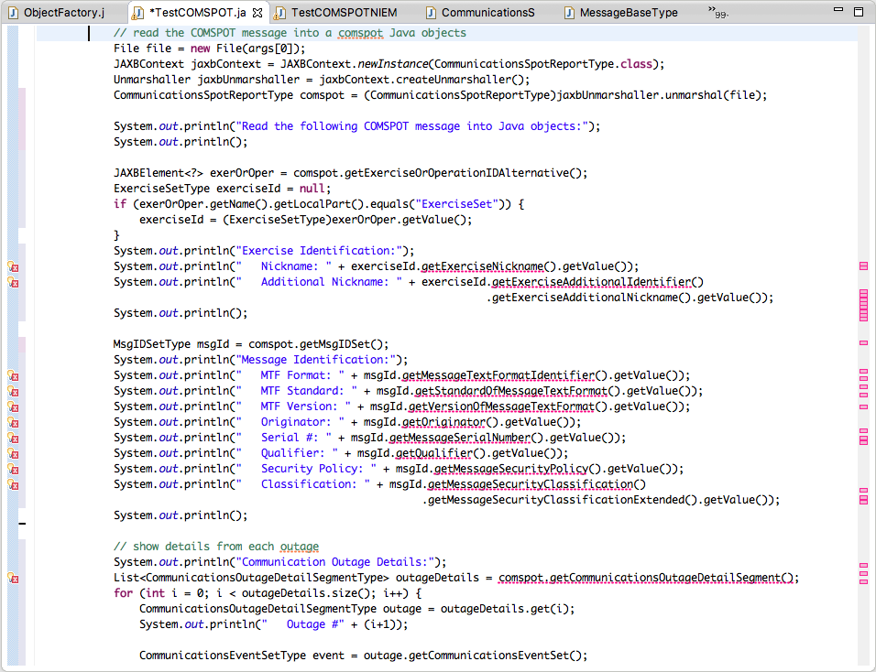
Impact of NIEM Schema Change
Fixing all these errors reveals 2 times more errors than we started with because the names and types for all fields, composites and alternates have also changed.

Slide 20
Impact of NIEM Schema Change
After fixing all the known errors, the program crashes due to the line above. Unlike Venetian Blind, the GoE schemas do not define a single top-level XML message. So, the code cannot assume JAXB will return a COMSPOT message.

Slide 21
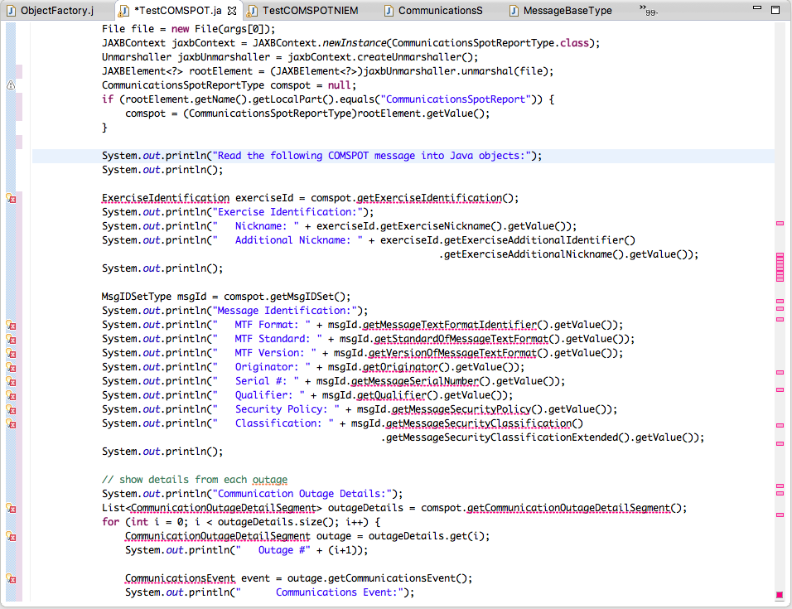
Impact of NIEM Schema Change
Since the root element is unknown with GoE, JAXB returns a generic element that must be inspected before it can be converted to a useful COMSPOT object. This requires 5 lines of code vs. the 1 line required with Venetian Blind schemas.

Slide 22
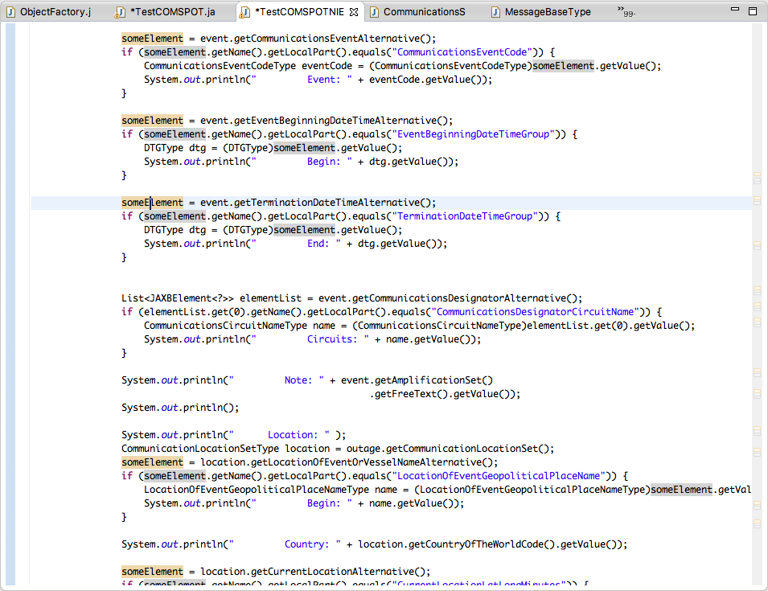
Impact of NIEM Schema Change
The same thing occurs for every substitution group. Substitution groups do not map well onto the type systems of popular programming languages. As such, the programmer has to write more code to determine which element was returned.

Slide 23
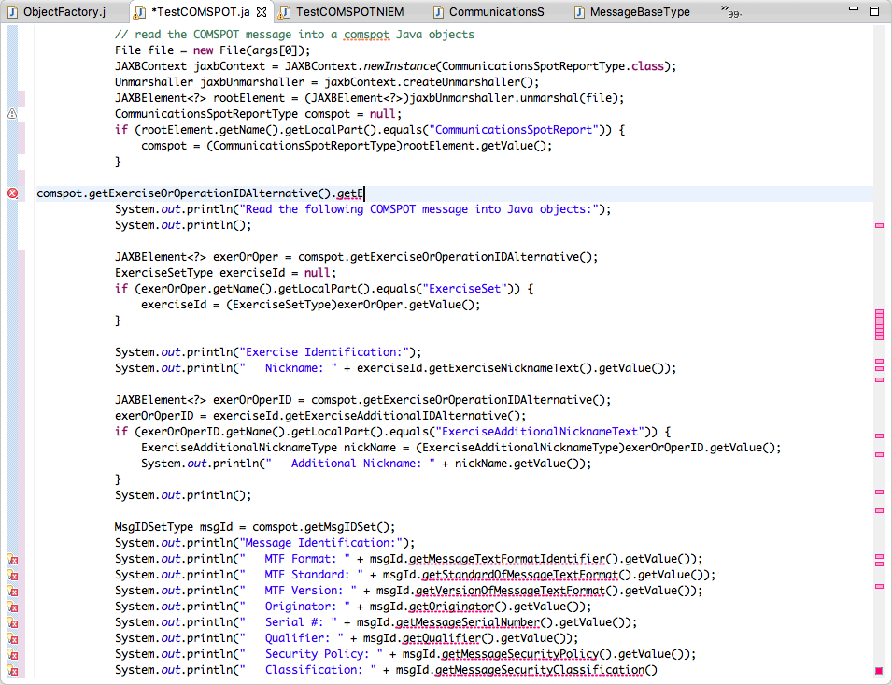
Impact of NIEM Schema Change
No list of available elements provided
In addition, the IDE can no longer provide code completion or help finding desired items in the message as it could before. This makes the code much more time consuming to write and maintain and requires manually combing through schemas.

Slide 24
Impact of NIEM Schema Change
<EventBeginningDateTimeGroup>
<TerminationDateTimeGroup>
GoE schemas result in more complex code where types, getters and XML element names no longer match. As such, the developer must comb through schemas to find type names.

Slide 25
Impact of NIEM Schema Change
In addition, the IDE cannot provide code completion, detect errors or detect changes for element names inside quotes. Errors in these names will fail silently, causing incorrect behavior.

Slide 26
Lessons Learned: XML Names are Really Important
Primary and best way for developers to identify specific information applications need from messages
More stable than contextual or positional identifiers (e.g., 2nd field in 3rd set in 1st segment)
Adding new names or moving old names is easy
Requires no code changes until application needs new item
Changing names is not easy -- every name change requires code changes -- everywhere the data is used
Note: This is a simple example with one small message
COMSPOT has 199 elements.
ATO has 1775. PURPLE has 1317. AIRSUPREQ has 824.
The best names are meaningful and stable

Slide 27
Names Changes not Limited to JAXB Impact all XML Interfaces
XSLT: <xsl:template match=“//MessageIdentifier/Originator” > …
XQuery/XPath: //CommunicationLocation[CountryOfTheWorld == ‘AFG’]”
SAX public void startElement(String uri, String localName, … if (localName.equals(“CommunicationsEvent”)) { ... else if (localName.equals(“TerminationDateTime”)) {
DOM ampn = document.getElementsByTagName(“Amplification”);
NIEM changes will break all these expressions

Slide 28
Lessons Learned Substitution Groups and GoE
No corresponding programming language construct
Binding maps to generic “JAXBElement” with no schema-driven assistance (e.g., code completion & help-text) or error checking
Significantly impacts application code
Increases code size & complexity (45% increase in our test)
Defeats IDE’s ability to provide code completion
Requires developers to manually lookup names in schemas
Cannot use example messages – names do not match
Defeats compiler’s error detection
Increases runtime errors in the code
Runtime errors are harder to find and fix
Requires greater testing efforts

Slide 29
Schema-Driven Editor Test
Purpose: evaluate what a typical XML Editor user will experience switching to new schemas
Process
Use 2016 COMSPOT schemas to create a message
Use NIEM COMSPOT schemas to create a message
Characterize level-of-effort and any notable issues

Slide 30
Schema-Driven Editor Test
Create new message using 2016 schemas
Create new message using NIEM schemas
Compare schema-driven help and validation
> Demo

Slide 31
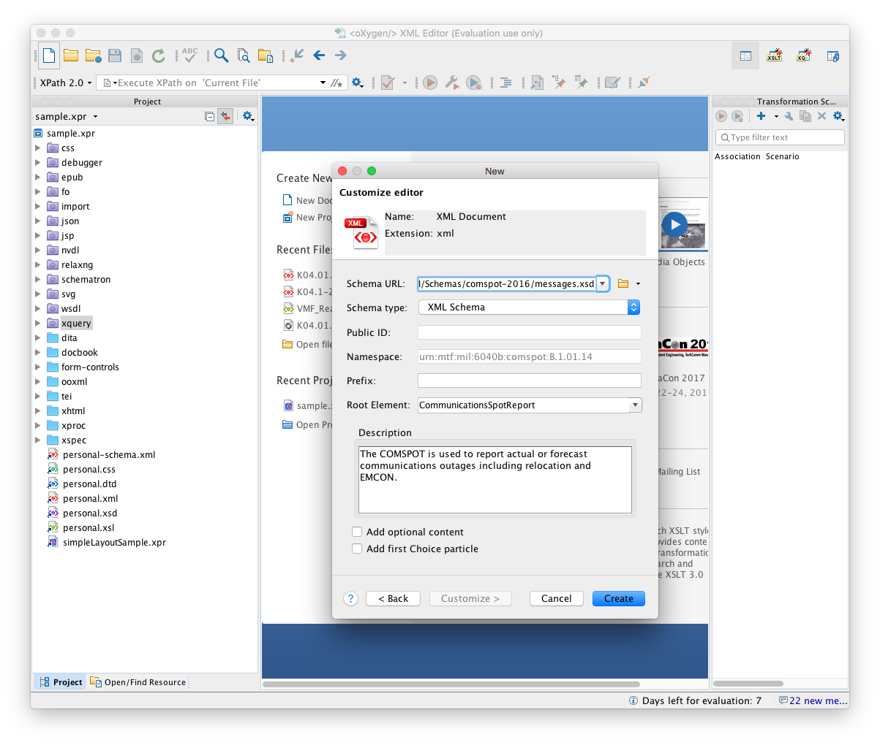
Create New Message Using 2016 Schemas
Choose schema
Click Create

Slide 32
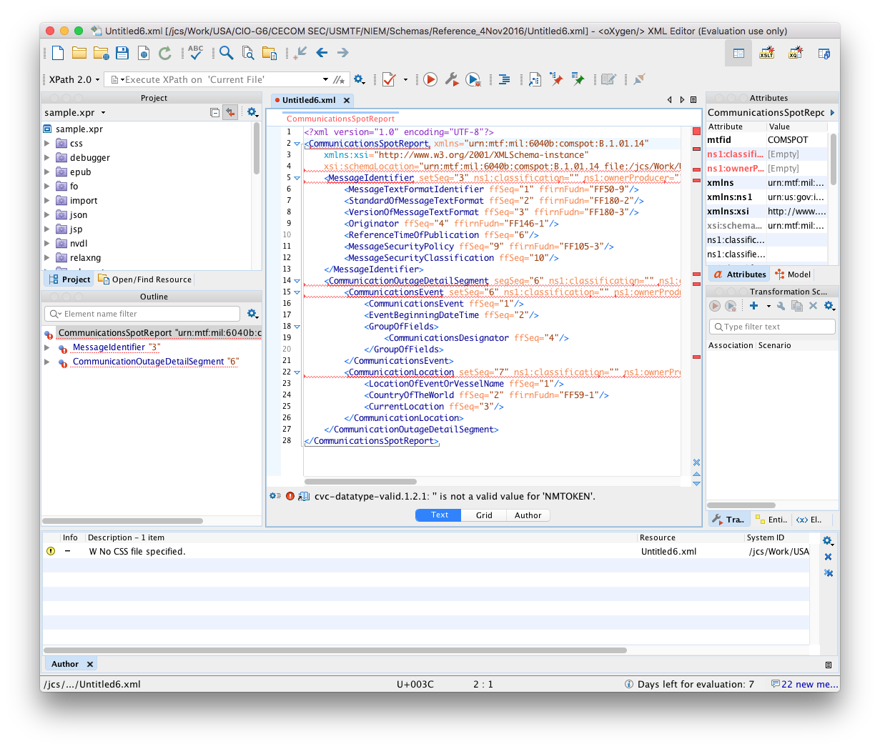
Create New Message Using 2016 Schemas
Editor creates new COMSPOT and provides empty template with mandatory items.

Slide 33
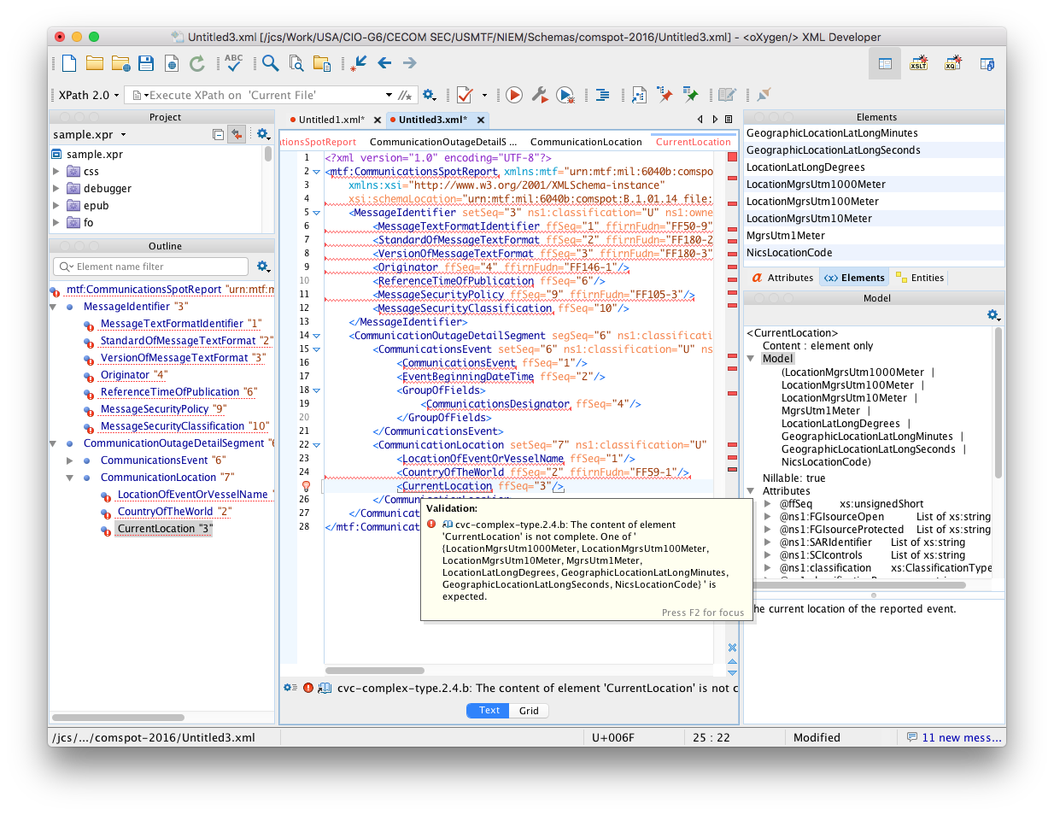
Schema-driven Help Using 2016 Schemas
Content model shows concise list
of elements permitted here.
Error indicates which elements
can be inserted to fix error.

Slide 34
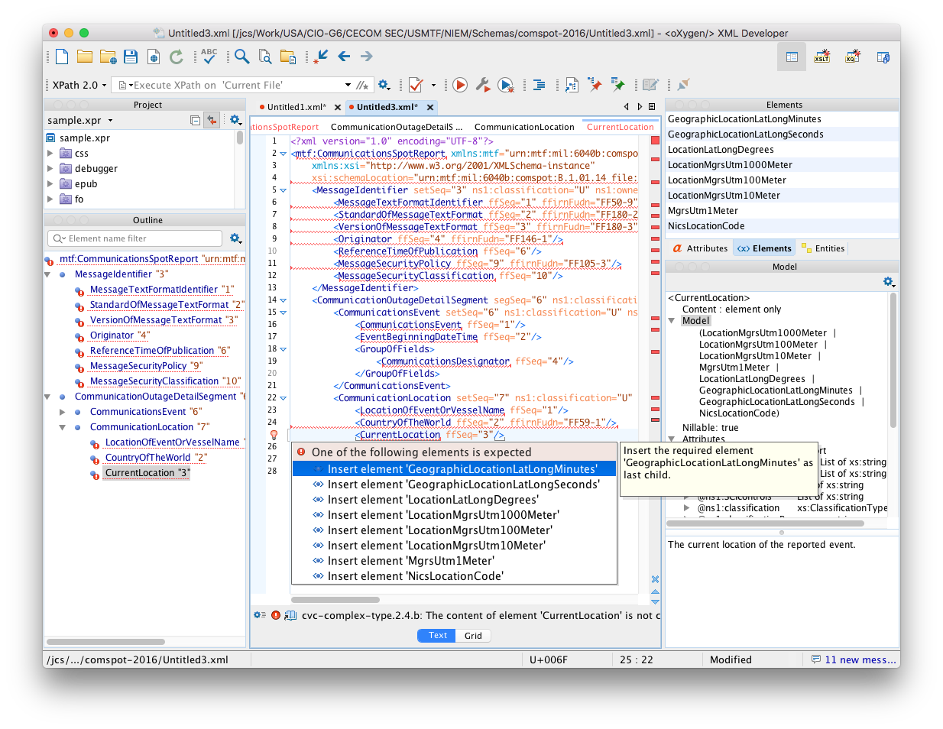
Schema-driven Help Using 2016 Schemas
“Quick fix” help offers solutions to fix error. Selecting one applies the fix.

Slide 35
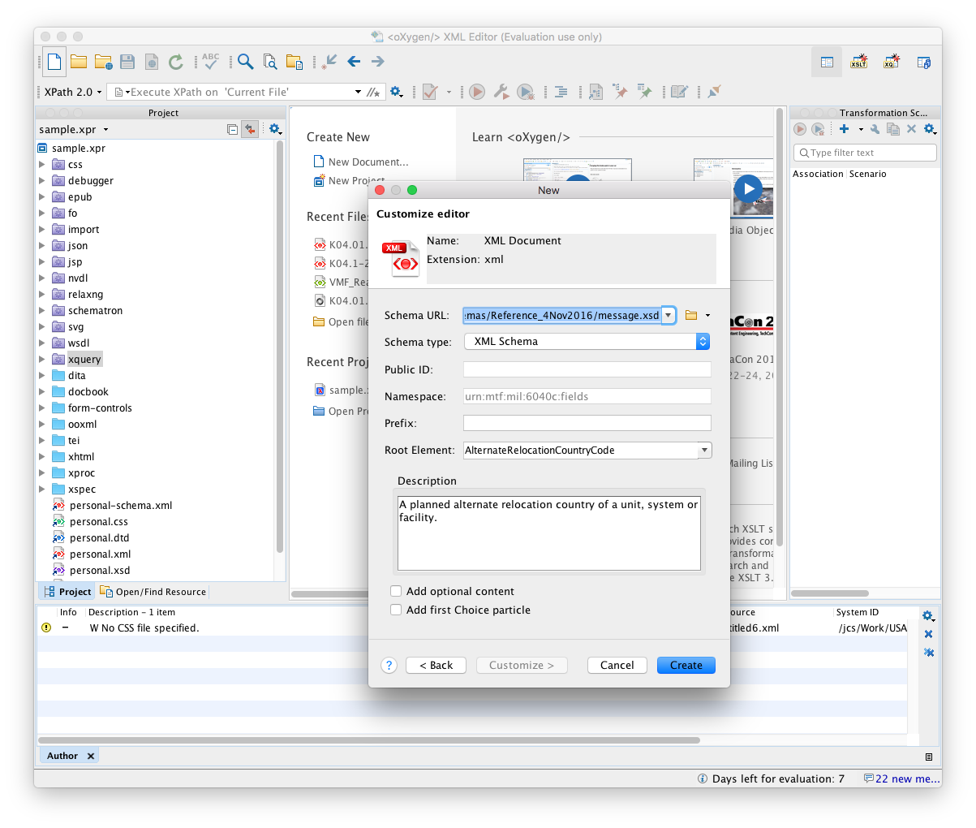
Create New Message Using NIEM Schemas
Choose schema
Click Create

Slide 36
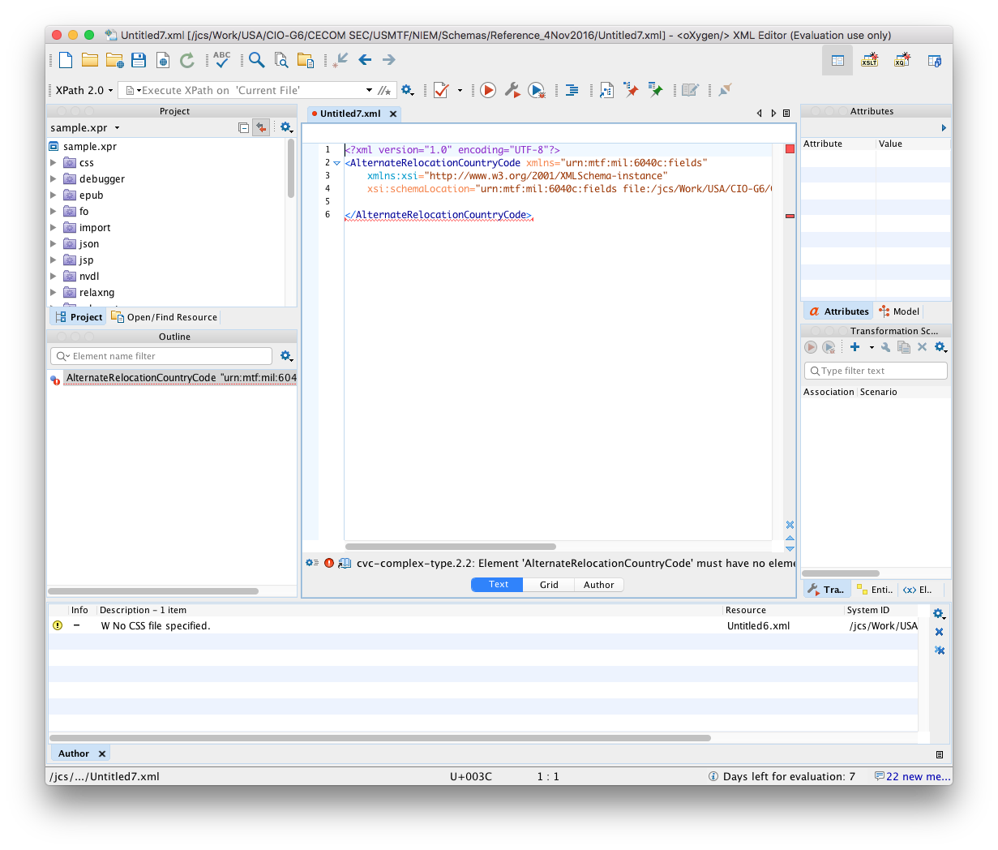
Create New Message Using NIEM Schemas
Editor creates new “AlternateRelocationCountryCode” message. What happened?

Slide 37
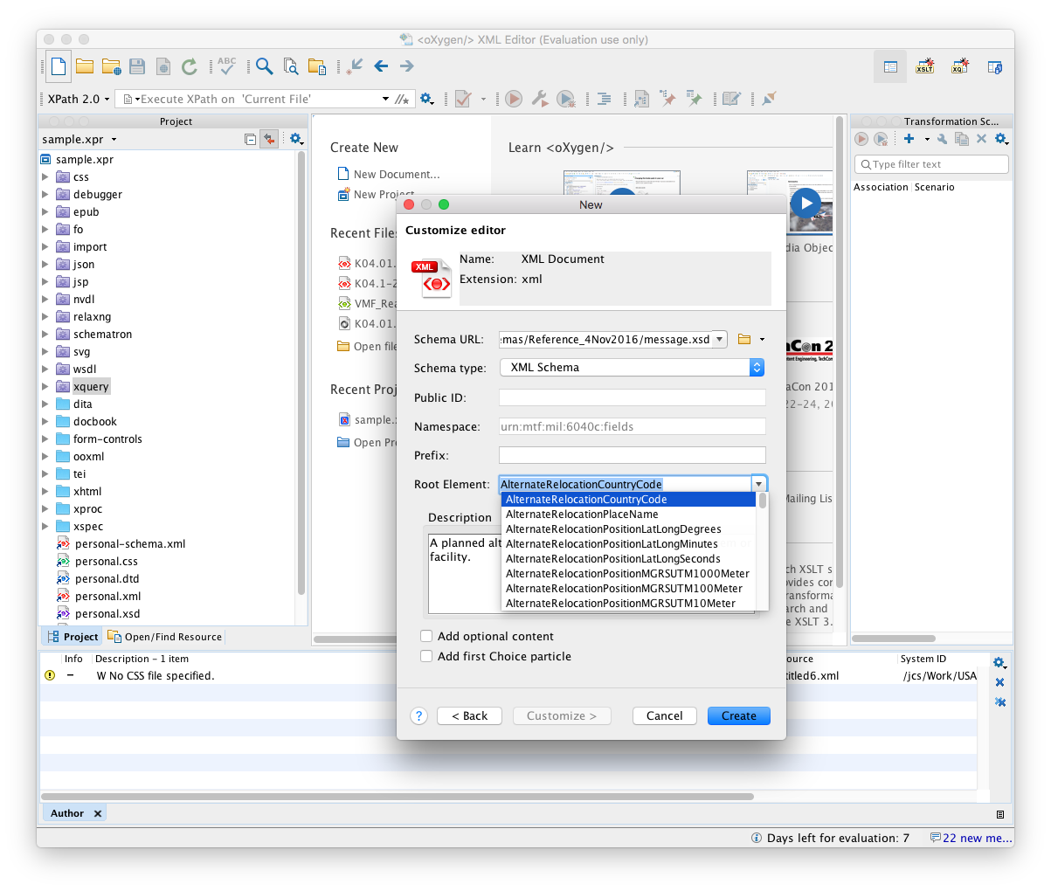
Create New Message Using NIEM Schemas
Returning to schema selection screen reveals this is one of about 170 possible messages defined by the COMSPOT schema. GoE makes all segs, sets, fields, etc. top-level elements, which means XML Schema considers them all valid messages.

Slide 38
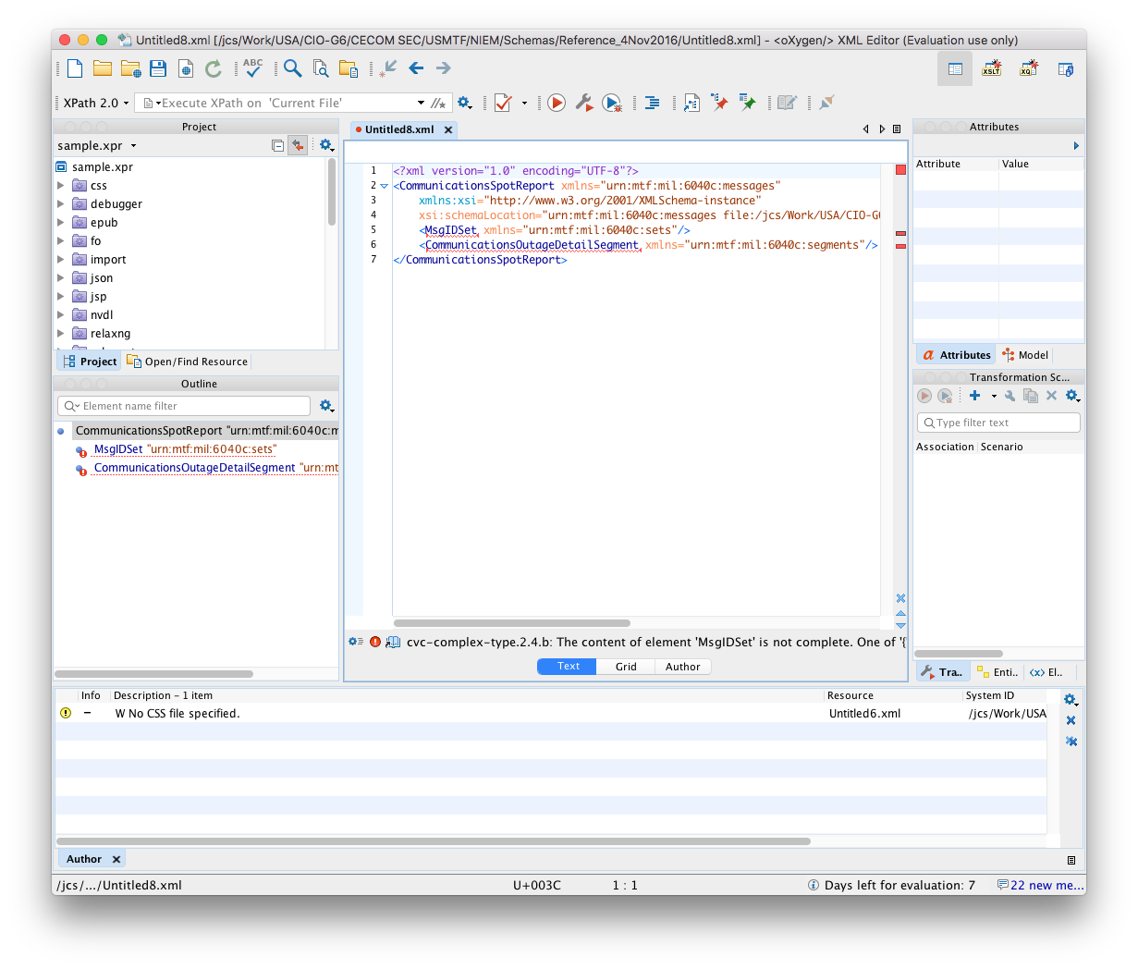
Create New Message Using NIEM Schemas
After scrolling through the list and selecting CommunicationsSpotReport, the user gets a blank template with far less completed (7 lines vs. 28 lines).

Slide 39
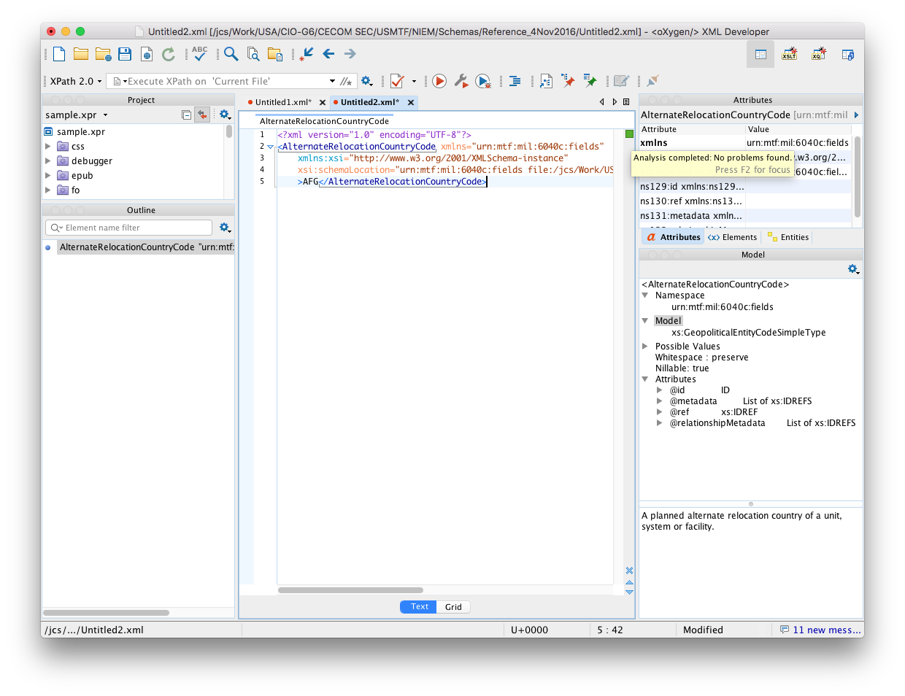
Create New Message Using NIEM Schemas
After inserting a country code into the original “AlternateRelocationCountryCode” message, the editor says it is a valid message according to the COMSPOT schema.

Slide 40
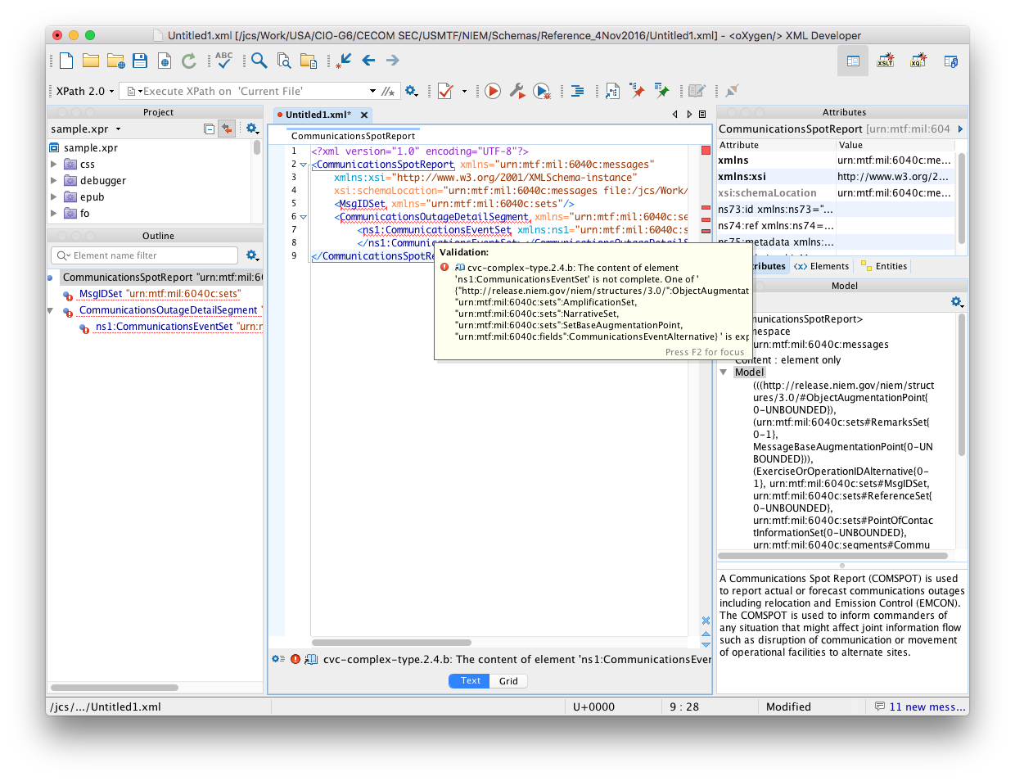
Schema-driven Help Using NIEM Schemas
Error indicates “abstract” element
missing vs. actual missing elements
Content model cluttered with “abstract”
elements, augmentation points and
excessive namespace declarations.

Slide 41
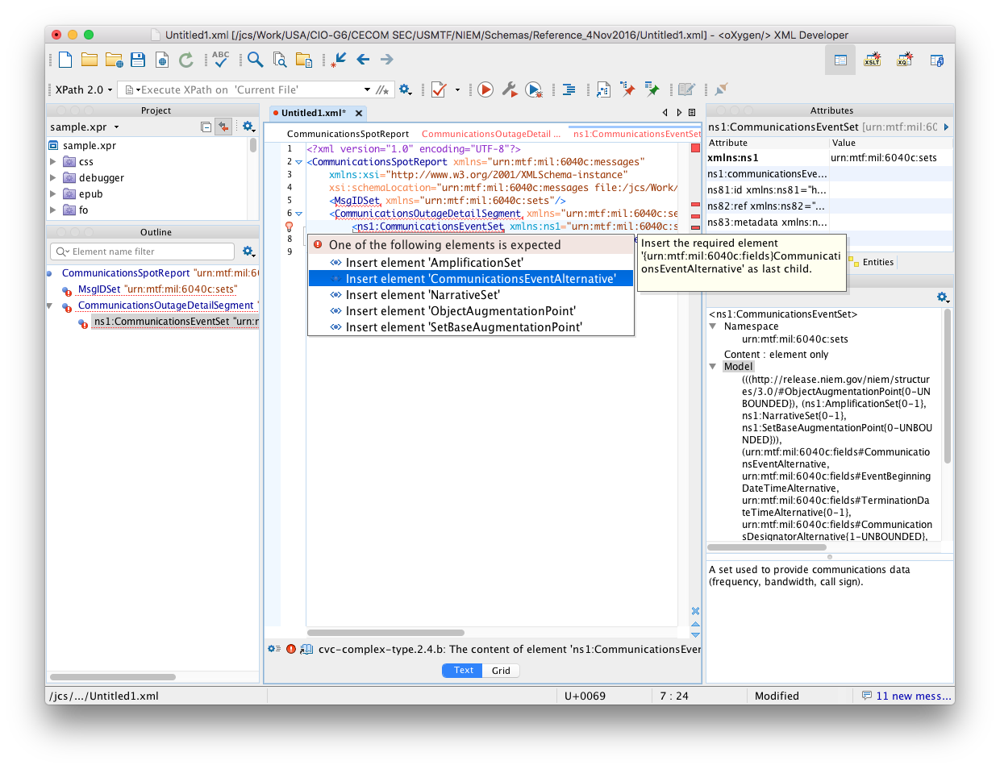
Schema-driven Help Using NIEM Schemas
Quick fix help incorrectly offers to insert “abstract” element rather than the correct elements. Choosing this option creates another error rather than fixing the error.

Slide 42
Lessons Learned Schema-Driven Editor
Garden of Eden
Each global element defines a valid message
NIEM schemas present users with hundreds / thousands of possible messages rather than one
Editor indicates any segment, set, or field is a valid message
Excessive namespace declarations clutter user interface
NIEM schemas auto-complete far less of message (inserts 3 rather than 19 required elements)
Substitution Groups
Reduce helpfulness of model help and error messages
Shows “abstract” elements rather than correct elements
Quick-fix inserts “abstract” elements rather than correct elements

Slide 43
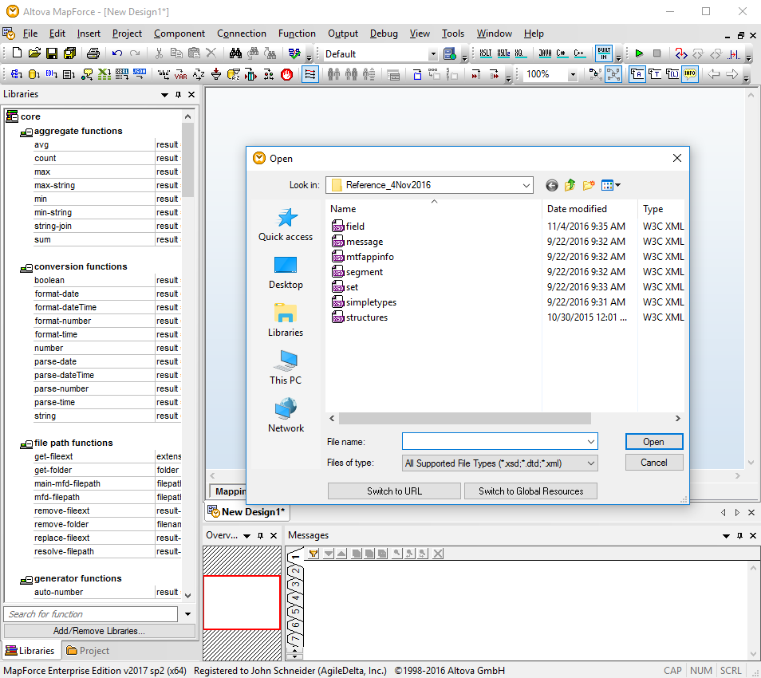
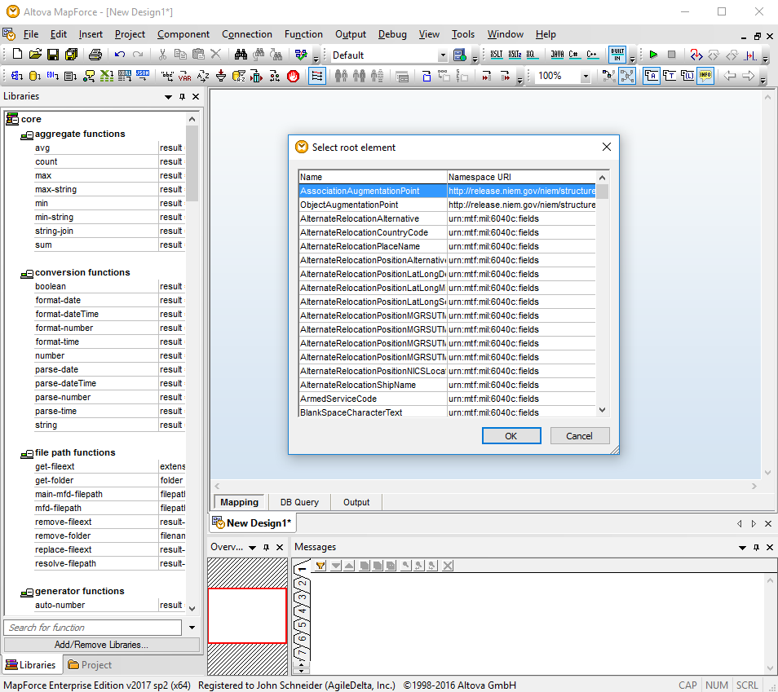
Same Effects with Other Tools E.g., Altova MapForce, XMLSpy
Shows 100s
of messages
Choose schema

Slide 44
Schema-Driven Validators
Check structure and content of a message against all schema constraints
Producers use as quality control before sending
Consumers use to verify incoming message before “trusting” and processing them
Guards use to ensure only known messages get through and as first check for malicious content

Slide 45
Schema-Driven Validator Test
Purpose: evaluate how NIEM schemas impact a standard XML validator (Apache Xerces)
Process
Validate COMSPOT message against 2016 schemas
Validate COMSPOT message against NIEM schemas
Characterize any notable differences

Slide 46
Schema-Driven Validator Test
Validate message against 2016 schemas
Validate message using NIEM schemas
Compare schema-driven help and validation
> Demo

Slide 47
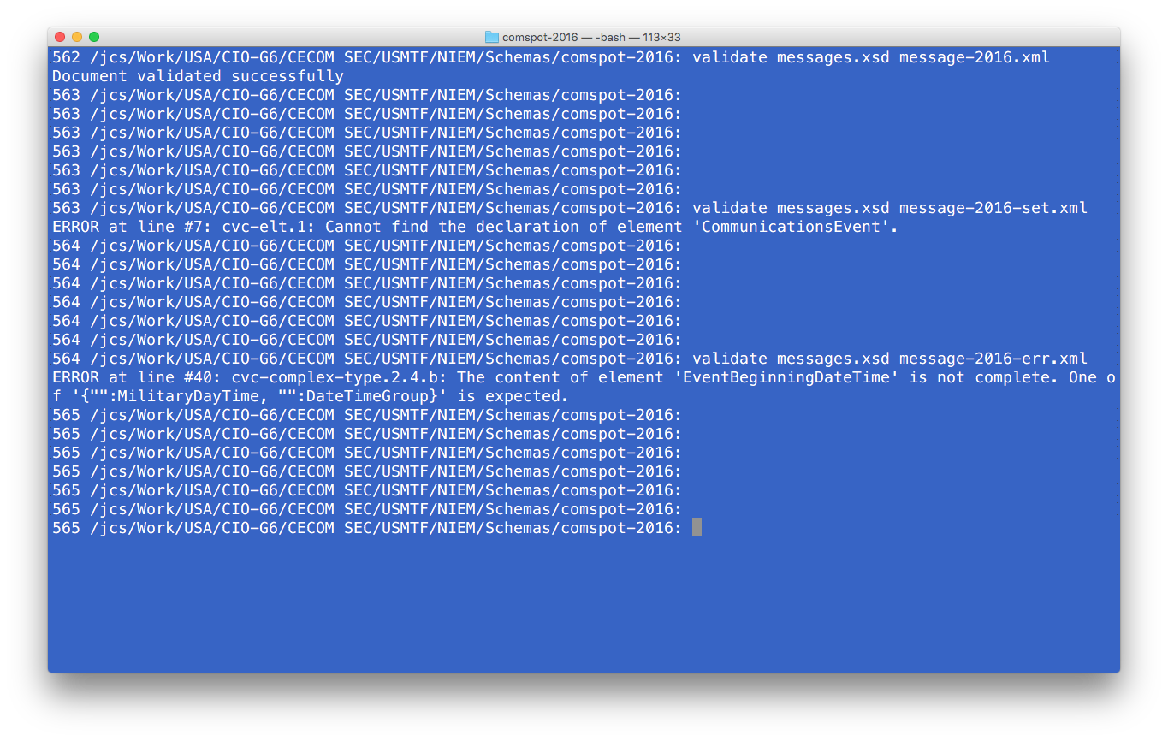
Validate Message using 2016 Schemas
Validator correctly identifies valid message
Validator correctly identifies incomplete message (single CommunicationsEvent set)
Validator correctly identifies missing element and indicates which elements will work in this location (MilitaryDayTime or DateTimeGroup)

Slide 48
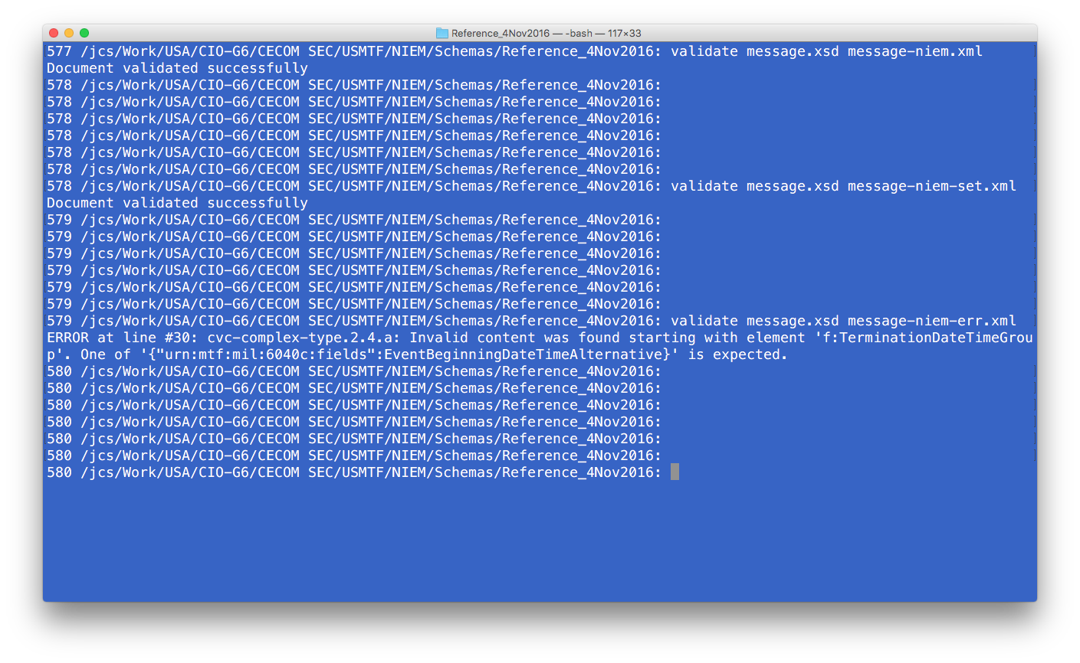
Validate Message using NIEM Schemas
Validator correctly identifies valid message
Validator indicates an incomplete message is valid (single CommunicationsEventSet set)
Validator correctly identifies missing set, but incorrectly identifies which sets will work in this position. EventBeginningDateTimeAlternative is an abstract set.

Slide 49
Lessons Learned Schema-Driven Validator
Garden of Eden
Validator indicates any segment, set, or field is a valid message and can no longer be used to detect valid / invalid messages
May require separate schemas be developed for guards
Substitution Groups
Reduces helpfulness of validator error messages
Reports missing “abstract” elements rather than correct elements
Augmentation points and excessive namespaces clutter displays and errors

Slide 50
Program Managers and Adoption
“POWER TO THE EDGE”

Slide 51

Program Manager Priorities
Maximize requirements delivered
With minimize cost, time and risk
Schedule
Requirements
Budget
Risk

Slide 52
The Challange
Never have the funds & time to do everything
Items that help meet funded requirements come first
Items with highest cost, effort and risk come last
Best bet is to minimize cost / benefit ratio
Unfunded
Requirements
Unfunded
Requirements
Mandates
Mandates
Risk: A high cost / benefit may delay implementation for many years

Slide 53
Thoughts and Recommendations
“POWER TO THE EDGE”

Slide 54
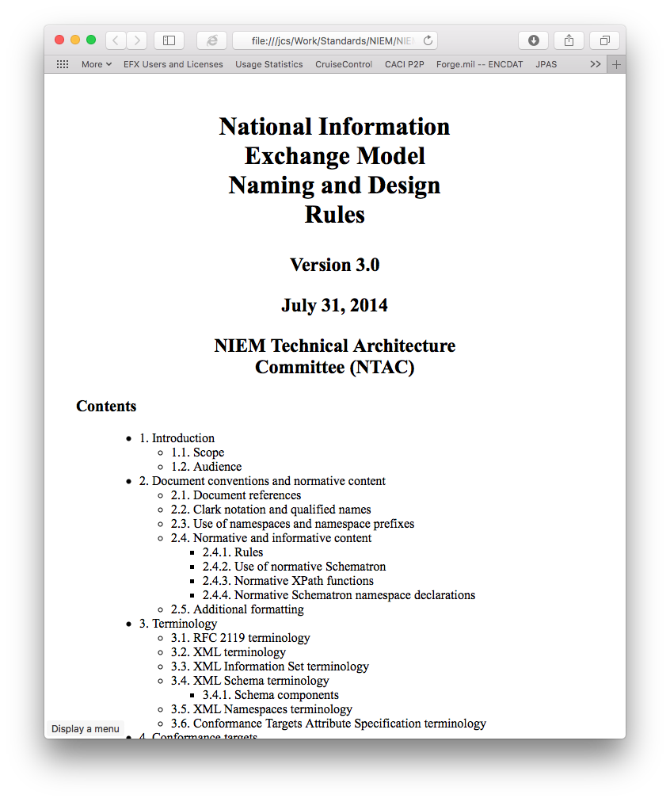
Minimize Name Changes Acronyms
Most acronym changes are not strictly required
“Acronyms and abbreviations have the ability to improve readability and comprehensibility of large, complex, or frequently used terms.”
“They also obscure meaning and impair understanding when their definitions are not clear or when they are used injudiciously. They should be used with great care.”
“[Rule 10-49]: The schema MUST use, in defined names, the abbreviations identified by Table 10.” (i.e., ID and URI)
Recommendation: Minimize changes. Adopt ID & URI. Document others “as is.”

Slide 55
Minimize Name Changes USMTF Local Terminology
Reduce USMTF “local” terminology
E.g., elements representing USMTF sets are not required to end with “Set”.
Minimize name changes to those strictly required to disambiguate names of sets, segments, fields, etc.
Use logical name changes that usefully identify the difference in purpose or meaning.
Note: Names that do not use USMTF terminology will appear less USMTF specific and are more likely to be reused by others.

Slide 56
Minimize Name Changes General
Consider applying other NIEM name changes incrementally (e.g., on new or modified items)
Avoid hitting program managers with a large, untenable cost all at once.
I.e., Boil the frog

Slide 57
Minimize Substitution Groups
NIEM strives for reuse of common components
“The goal is to maximize interoperability and reuse.”
“A real-world entity should be modeled in only one way. The definition of a type or element should appear once and only once.”
“Multiple components of identical or closely similar semantics hinder interoperability because too many valid methods exist for representing the same data. For each data concept that must be represented, there should be only one component (and associated type) to represent it.”

Slide 58
Minimize Substitution Groups
However, NIEM uses XML Schema 1.0
Restricts each element to a single substitution group
Not possible to reuse a common representation of general purpose data concepts across substitution groups.
Unintended consequence
Many general purpose elements that were widely reused must be converted to duplicate, special purpose representations
CircularAreaSet | StartPositionCircularAreaSet
HavenCircularAreaSet | WaitPositionCircularAreaSet
SubmarineOperatingAreaCircularAreaSet | MissileSeekerZoneCircularAreaSet
AEWEmploymentCircularAreaSet | TASMsnCircularAreaSet
EWAircraftEmploymentCircularAreaSet | MPAMsnCircularAreaSet
FEZCircularAreaSet | FixedWingASWMsnCircularAreaSet
MEZCircularAreaSet | HeloMsnCircularAreaSet
TGTAreaReportingCircularAreaSet | SubmarineMsnCircularAreaSet
FastPatrolBoatCircularArea | SonobuoyInterferenceAvoidanceCircularAreaSet
SurveilanceOpsAreaCircularArea | DustbinAreaCircularAreaSet
CircularArea
Becomes 26 total elements
Recommendation: Raise this issue with NIEM. Not likely the intended effect.

Slide 59
Reduce Reference Schemas
The primary source of substitution group issues
“A reference schema document is a schema document that is intended to provide the authoritative definitions of broadly reusable schema components.”
“Reference schema documents are intended to be as regular and simple as possible.”
Intended for most general, most abstract core concepts
Does not apply to all MTF segs, sets, fields
Probably do not want 1000s from us
May want to hold off until substitution group issues are resolved

Slide 60
Garden of Eden
Impacts programs and end users
Makes coding web-services more time-consuming, complex, error-prone (similar to substitution groups)
Makes user experience more complex, time-consuming, error-prone
Removes ability to use schema validation for release control, error-detection, guards.
I.e., there may be an apple in the GoE
Recommendation: Raise this issue with NIEM. Not likely the intended consequences.

Slide 61
Engage with NIEM
USMTF is probably the largest program to which NIEM has been applied
Provides a fantastic way to get NIEM to programs
Provides an important source of lessons learned
Identify unintended consequences and effects on program and user adoption
Work with NIEM to make it more widely adopted and attractive to programs.
Work on less disruptive transition strategies for large, existing programs

Slide 62
And Finally …
“Test everything; retain what is good.”
Testing is important before finalizing standards
No matter how many smart experts review a big change, they won’t find everything
Testing will identify complex interactions and unanticipated consequences
And … socialize changes with programs and solicit feedback
Recommendation: Before approval, implement more messages. Test them.

Slide 63
Summary
Objective
Ensure changes are adopted by programs without lengthy delay
Testing results
Name changes require significant code changes
Substitution groups and GoE make coding web-services more time-consuming, complex, error-prone
Substitution groups and GoE make user experience more complex, time-consuming, error-prone
Recommendations
Minimize name changes (acronyms, USMTF local terms)
Minimize substitution groups, reference schemas and GoE
Engage with NIEM to share lessons learned
Do more testing before finalizing this change

Slide 64
Questions?
“POWER TO THE EDGE”

